Slide 1

16CS207: Formal Languages and Automata Theory
(FLAT)
P.Ramadoss
Assistant Professor,
Department of Information Technology,
VFSTR (Deemed to be)University,
Guntur, Andhra Pradesh.

Slide 2
Objectives
Introduce concepts in automata theory and theory of computation.
Identify different formal language classes and their relationships

Slide 3
Outcomes
Students can able to understand the concepts of ε-NFA, DFA and Subset Construction.
The student will be able to demonstrate abstract models of computing, including deterministic (DFA), non-deterministic (NFA).

Slide 4
Textbook
Introduction to Automata Theory, Languages and Computation.
By J.E. Hopcroft, and Ullman
^{2rd} Edition
Pearson/Prentice Hall India, 2007.
Notes:
Cpt S 317: Automata & Formal Languages
School of EECS, WSU

Slide 5
FA with ε-Transitions
It is possible in NFA that an NFA is allowed to make transition spontaneously without receiving an input symbol. This move is called ε-transitions.
i.e., a transition from one state to another state without consuming any additional input symbol.
These ε-transitions represents “any number off times”.
Definition: NFAs are those NFAs with at least one explicit transition defined.
ε -NFAs have one more column in their transition table.

Slide 6
The formal notation of ε-NFA
We represents an ε-NFA by A = (Q, ∑, 𝛿, qo, F),
Where all components have their same interpretation as for an NFA.
Q = Finite set of states,
∑= Finite set of input symbols
𝛿= A transition function that maps Q X ∑ ∪ {ε}→ 2^{Q}
qo: A start state; qo∈Q
F= Set of ﬁnal states; F ⊆ Q.

Slide 7
Example#1:
Construct NFA with ε which accepts a language consisting the strings of any number of a’s followed by any number of b’s followed by any number of c’s.
Notes:
Cpt S 317: Spring 2009
School of EECS, WSU

Slide 8
c
a
b
Symbols
Start
ε
ε
a
b
C
ε
q₀
q₁
q₂
q₀
{q₀}
Φ
Φ
{q₁}
Q = {q₀,q₁,q₂}
Σ = {a,b,c}
start state = q₀
F = {q₂}
Transition table
q₁
Accepting
state
Φ
{q₁}
Φ
{q₂}
States
*q₂
Φ
Φ
{q₂}
Φ
Notes:
Cpt S 317: Spring 2009
School of EECS, WSU

Slide 9
We can parse the string aabbcc as follows:-
δ(q₀,aabbcc) ├ δ (q₀,abbcc)
├ δ (q₀,bbcc)
├ δ (q₀,εbbcc)
├ δ (q₁,bbcc)
├ δ (q₁,bcc)
├ δ (q₁,cc)
├ δ (q₁, εcc)
├ δ (q₂, cc)
├ δ (q₂, c)
├ δ (q₂, ε)
Thus we can reach to accept state, after scanning the complete input string.

Slide 10
Epsilon Closure:
Informally ε-closure of a state is all transitions out of that state are labeled ε.
ε-closure (q) is set of all state which are reachable from q on ε-Transitions.

Slide 11
Example#1: Find ε-closure of all states
0
2
1
Start
ε
ε
q₀
q₁
q₂
Accepting
state
ε-closure (q₀)= {q_{0,}q_{1,} q₂}
ε-closure (q₁)= {q_{1,} q₂}
ε-closure (q₂)= {q₂}
Notes:
Cpt S 317: Spring 2009
School of EECS, WSU

Slide 12
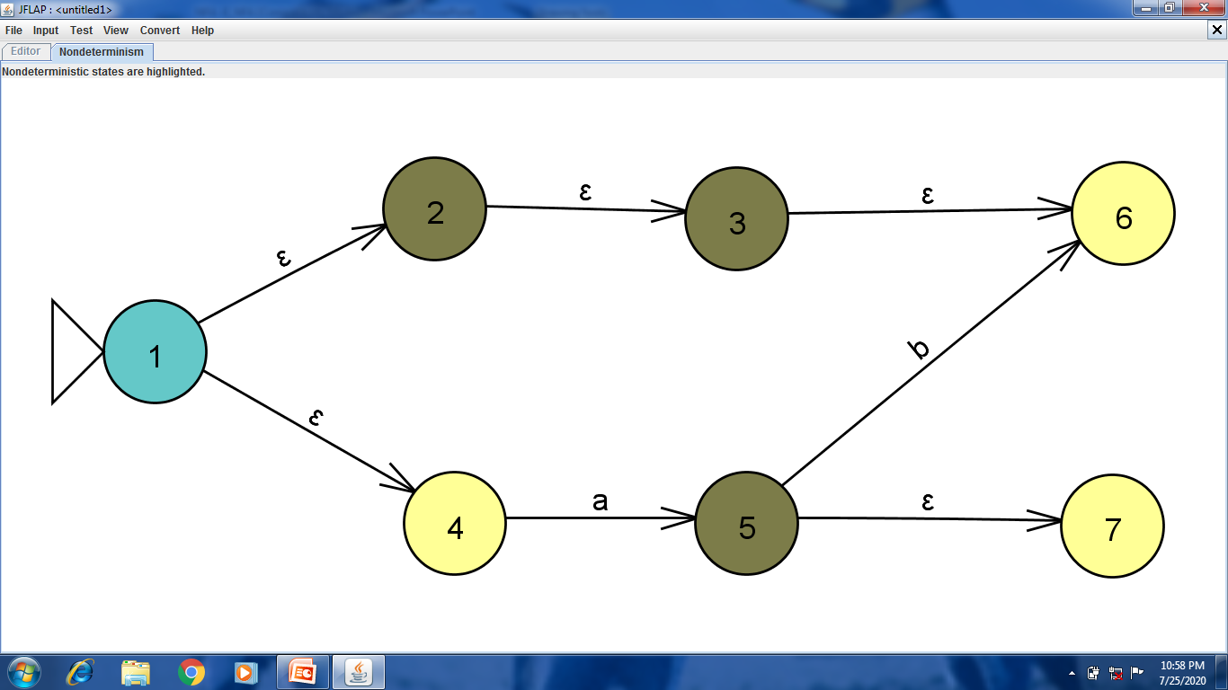
Example#2: Find ε-closure(1), ε-closure(2), ε-closure(5).
Notes:
Cpt S 317: Spring 2009
School of EECS, WSU

Slide 13
Solution:
ε-closure (1)= {1,2,3,4,6}
ε-closure (2)= {2,3,6}
ε-closure (5)= {5,7}
Notes:
Cpt S 317: Spring 2009
School of EECS, WSU

Slide 14
Construct NFA without ε-move from given NFA with ε ?
b
Since ε-closure (q₀) contains final state q_{1,} add q₀ also in
set of final States for NFA without ε-moves.
F’={q_{0,}q₁}
δ (q_{0,} ε)= ε-closure (q₀) = {q_{0,}q₁}
a
Start
ε
q₀
q₁
ε-closure (q₀)= {q_{0,}q₁}
Notes:
Cpt S 317: Spring 2009
School of EECS, WSU

Slide 15
F’={q_{0,}q₁}
δ (q_{0,} ε) = ε-closure (q₀) = {q_{0,}q₁}
δ’(q_{0,} a) = δ (q_{0,} a)
δ(q_{0,} a) = ε-closure (δ (δ (q_{0,} ε),a)
= ε-closure (δ ({δ {q_{0,}q₁},a) }
= ε-closure (δ (q_{0,} a) ∪ δ (q_{1,}a))
= ε-closure (q_{0,} ∪ )
= ε-closure (q₀)
= {q_{0,}q₁}
Φ
Notes:
Cpt S 317: Spring 2009
School of EECS, WSU

Slide 16
δ’(q_{0,} b) = δ (q_{0,} b)
δ (q_{0,} b) =ε-closure (δ (δ (q_{0,} ε),b))
= ε-closure (δ ({q_{0,}q₁},b))
= ε-closure (δ (q_{0,} b) ∪ δ (q_{1,}b))
= ε-closure ( ∪ q₁)
= ε-closure (q₁)
= {q₁}
Φ
Notes:
Cpt S 317: Spring 2009
School of EECS, WSU

Slide 17
δ’(q1, a) = δ (q_{1,} a)
δ (q1, a) =ε-closure (δ (δ (q1, ε),a))
= ε-closure (δ ({q₁},a))
= ε-closure (δ (q_{1,}a))
= ε-closure ( )
=
δ’(q1, b) = δ (q_{1,} b)
δ (q1, b) =ε-closure (δ (δ (q1, ε),b))
= ε-closure (δ ({q₁},b))
= ε-closure (δ (q_{1,}b))
= ε-closure (q₁)
= {q₁}
STATE | INPUT
 | a | b
q₀ | {q_{0,}q₁} | {q₁}
q₁ |  | {q₁}
Φ
Φ
a
b
Φ
a / b
Start
q₀
q₁
Fig NFA with out ε
Notes:
Cpt S 317: Spring 2009
School of EECS, WSU

Slide 18
Equivalence of DFA’s, NFA’s
A DFA can be turned into an NFA that accepts
the same language.
If δ_{D}(q, a) = p, let the NFA have δ_{N}(q, a) = {p}.
Then the NFA is always in a set containing
exactly one state – the state the DFA is in after
reading the same input.

Slide 19
NFA to DFA by subset construction
Let N = {Q_{N},∑,δ_{N},q₀,F_{N}}
Goal: Build D={Q_{D},∑,δ_{D},{q₀},F_{D}} s.t. L(D)=L(N)
Construction:
  Q_{D}= all subsets of Q_{N} (i.e., power set)
  F_{D}=set of subsets S of Q_{N} s.t. S∩F_{N}≠Φ
  δ_{D}: for each subset S of Q_{N} and for each input symbol a in ∑:
    δ_{D}(S,a) = U δ_{N}(p,a)A
p in s
Notes:
Cpt S 317: Spring 2009
School of EECS, WSU

Slide 20
Equivalence
Surprisingly, for any NFA there is a DFA that
accepts the same language.
The number of states of the DFA can be
exponential in the number of states of the NFA.
Thus, NFA’s accept exactly the regular languages.

Slide 21
Subset Construction
Given an NFA with states Q, inputs Σ,
transition function δ_{N}, state state q₀,
and final states F, construct equivalent DFA with:
  States 2^{Q} (Set of subsets of Q).
  Inputs Σ.
  Start state {q₀}.
  Final states = all those with a member of F.

Slide 22
Example1: We’ll construct the DFA equivalent of our “chessboard” NFA.
1
2
3
R B
2,4 5
4,6 1,3,5
2,6 5
2,8 1,5,7
2,4,6,8 1,3,7,9
2,8 3,5,9
4,8 5
4,6 5,7,9
6,8 5
4
5
6
7
8
9
r
b
b
*
1
2
1
5
4
3
1
5
3
7
7
9
Accept, since final state reached

Slide 23
Example 1: Moves on a Chessboard
States = squares.
Inputs = r (move to an adjacent red square) and b (move to an adjacent black square).
Start state, final state are in opposite corners.

Slide 24
Example 1: Subset Construction
R B
2,4 5
4,6 1,3,5
2,6 5
2,8 1,5,7
2,4,6,8 1,3,7,9
2,8 3,5,9
4,8 5
4,6 5,7,9
6,8 5
R B
{1}
{2,4} {5}
{2,4}
{2,4,6,8} {1,3,5,7}
{5}
{2,4,6,8} {1,3,7,9}
{2,4,6,8}
{2,4,6,8} {1,3,5,7,9}
{1,3,5,7}
{2,4,6,8} {1,3,5,7,9}
* {1,3,7,9}
{2,4,6,8} {5}
* {1,3,5,7,9}
{2,4,6,8} {1,3,5,7,9}
*

Slide 25
Example 2: ε-NFA ➔ DFA
L = {w | w is empty, or if non-empty will end in 01}
0
{q₀,q₁}
0
0,1
{q₀,q₂}
0
1
0
1
0
q₀
q₁
q₂
{q’₀, q₀}
1
start
1
ε
q₀
1
start
q’₀
ECLOSE
union
δ_{E} | 0 | 1 | ε
*q’₀ | Ø | Ø | {q’₀,q₀}
q₀ | {q₀,q₁} | {q₀} | {q₀}
q₁ | Ø | {q₂} | {q₁}
*q₂ | Ø | Ø | {q₂}
δ_{D} | 0 | 1
*{q’₀,q₀} | {q₀,q₁} | {q₀}
{q₀,q₁} | {q₀,q₁} | {q₀,q₂}
{q₀} | {q₀,q₁} | {q₀}
*{q₀,q₂} | {q₀,q₁} | {q₀}
Notes:
Cpt S 317: Spring 2009
School of EECS, WSU

Slide 26
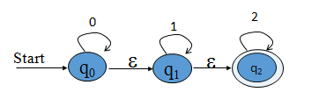
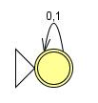
Exercise
Convert following NFA to DFA.
Find the set of strings accepted by the finite automata.
Notes:
Cpt S 317: Spring 2009
School of EECS, WSU

Slide 27


Summary
FA with ε-Transitions
  ε-NFA Definition
  Transition diagrams & tables
Epsilon Closure:
NFA without ε-move
Equivalence of DFA’s, NFA’s
Subset Construction
Notes:
Cpt S 317: Spring 2009
School of EECS, WSU

Slide 28
THANK YOU
Notes:
Cpt S 317: Spring 2009
School of EECS, WSU

